Slide 1




INNOVEXA STORE E-COMMERCE WEBSITE
PRESENTATION
BY CREATED USING: HTML &CSS
KIET GROUP OF INSTITUTIONS, DELHI-NCR, GHAZIABAD-201206 BY: ANKIT KUMAR-roll –UID-202510116100032
ADITYA RAJ JAISWAL-roll-UID-202510116100012
ASHWANI roll-202510116100058
AYUSH KUMAR roll-202510116100060
In Supervision – Mr. Vijay Kumar

Slide 2

INNOVEXA STORE
KIET GROUP OF INSTITUTIONS, DELHI-NCR

Slide 3
Project Overview: Evolving to Dynamic E- Commerce
FUNCTIONAL, USER-CENTRIC PLATFORM
The INNOVEXA STORE transforms from a static HTML site to a dynamic, responsive e-commerce application focused on user engagement and efficiency.

Slide 4
Project Objectives
ROBUST FRONT-END ARCHITECTURE
Establishing a solid architecture will enhance user experience through efficient navigation and seamless interactions within the e-commerce platform.
FUNCTIONAL LOGIC
Implementing dynamic logic ensures real-time updates for product rendering and cart management, improving overall performance and user satisfaction.
COMPONENTIZED UI
Developing reusable UI components promotes maintainability and scalability, allowing for consistent styling and easy updates across the application.

Slide 5
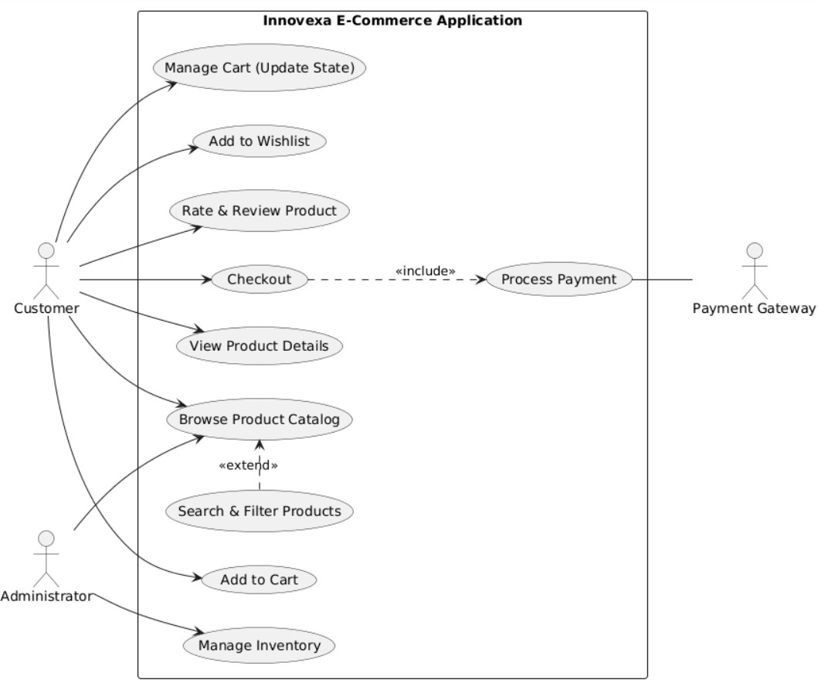

Slide 6
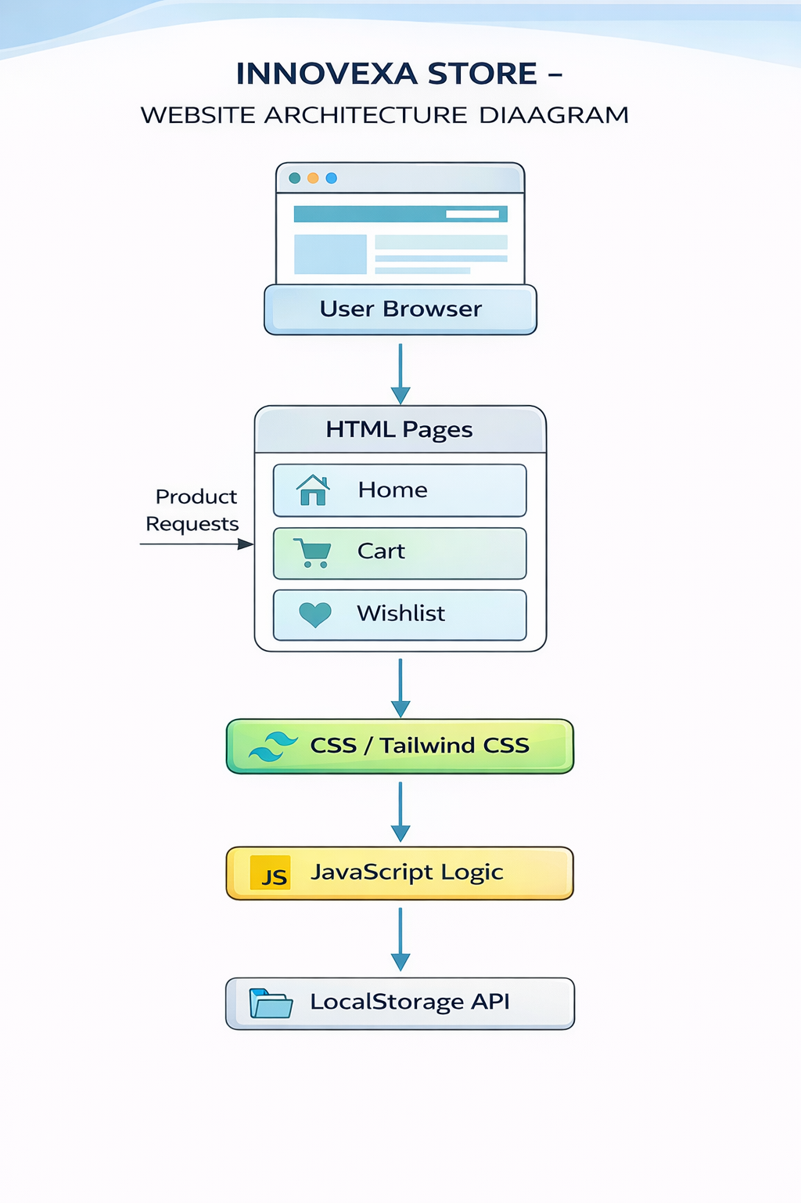

Slide 7
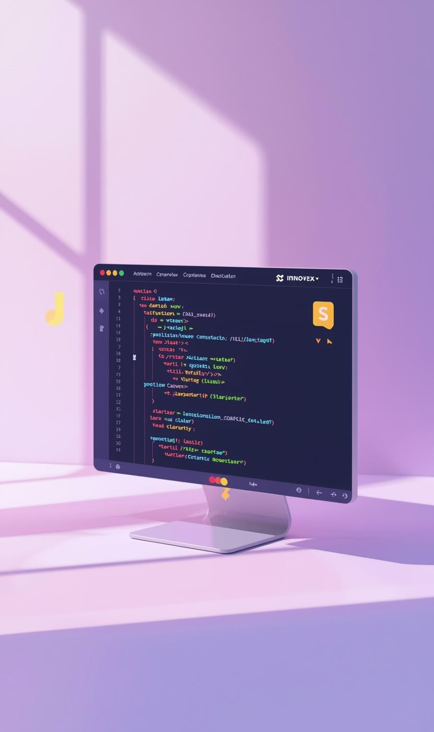
Tools and Technologies Overview
ESSENTIAL DEVELOPMENT TOOLS
We utilize HTML5, CSS3, and JavaScript ES6+ for creating a dynamic e- commerce web application, leveraging Visual Studio Code for efficient development.

Slide 8
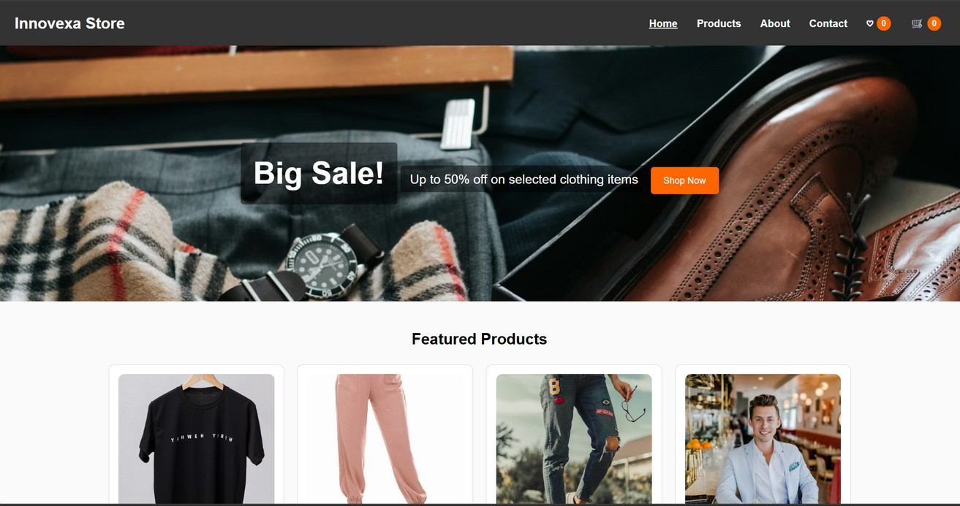
Tailwind CSS: Utility-First Design Principles
INSPIRATION
Consistent design through utility classes and spacing

Slide 9
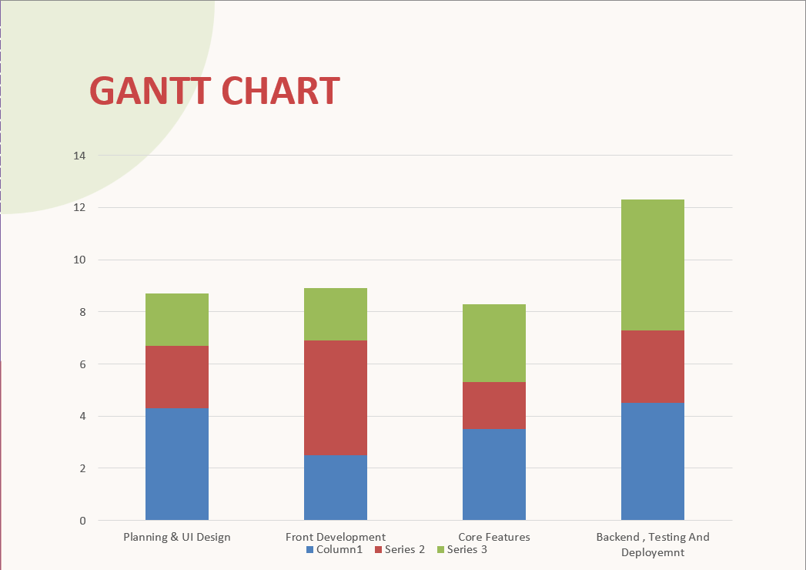

Slide 10
Functional Web Application Logic
DYNAMIC USER INTERACTIONS
Dynamic content rendering through JavaScript for real-time updates. State management ensures accurate tracking of cart items and totals. Data persistence is achieved via LocalStorage API, preserving user data across sessions.

Slide 11
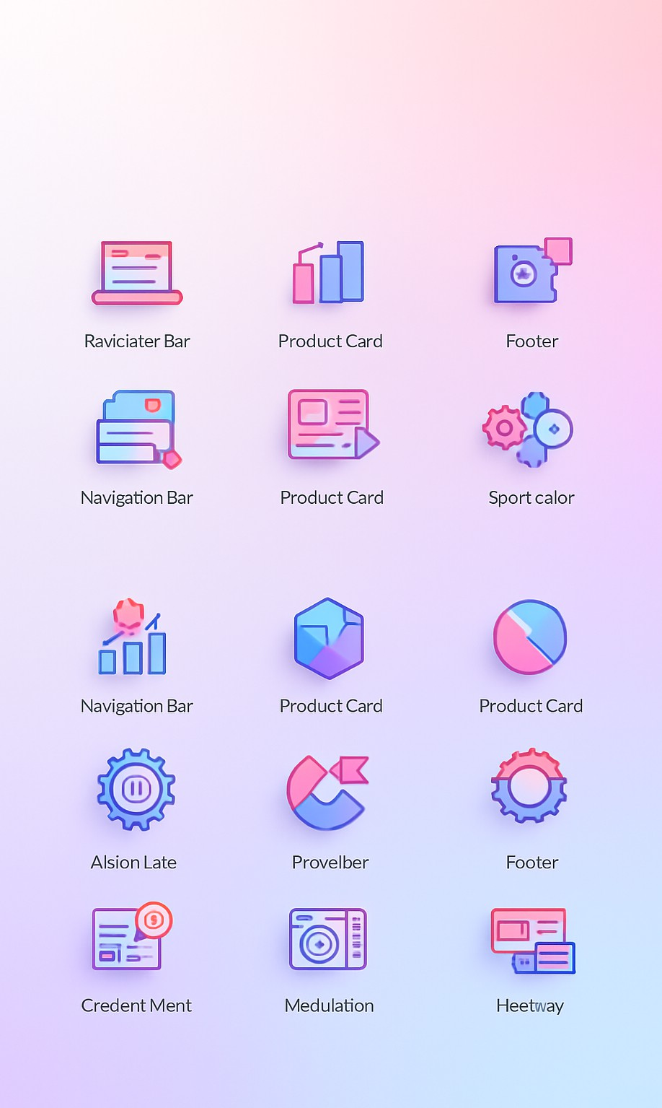
Componentization and Modular Design Principles
REUSABLE UI COMPONENTS
The project employs a modular architecture, creating reusable components like navigation bars and product cards, enhancing maintainability and scalability.

Slide 12
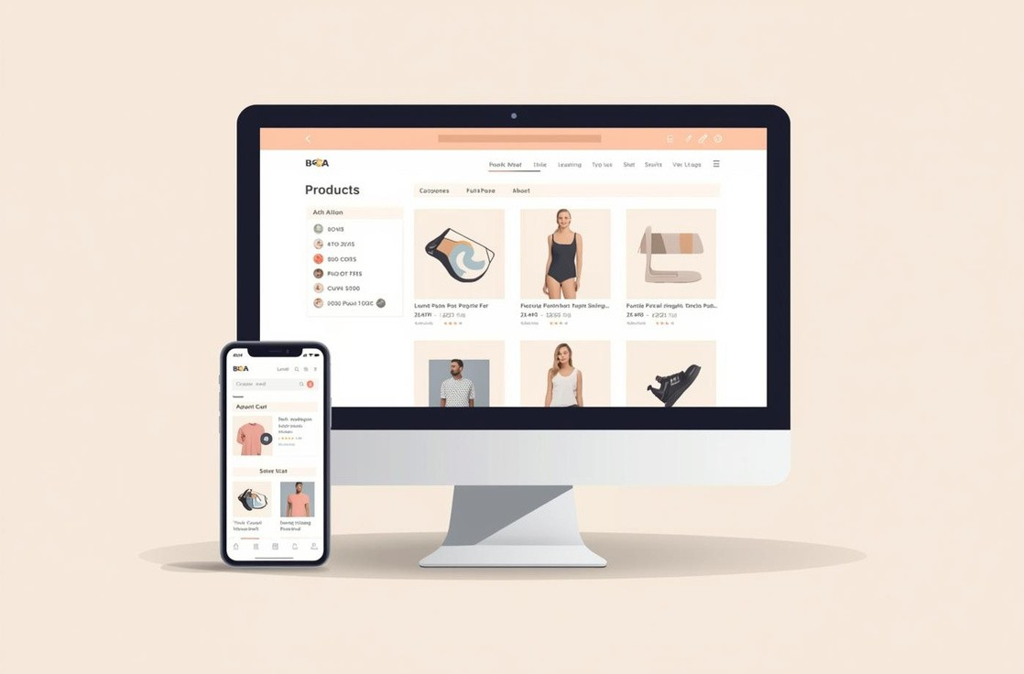
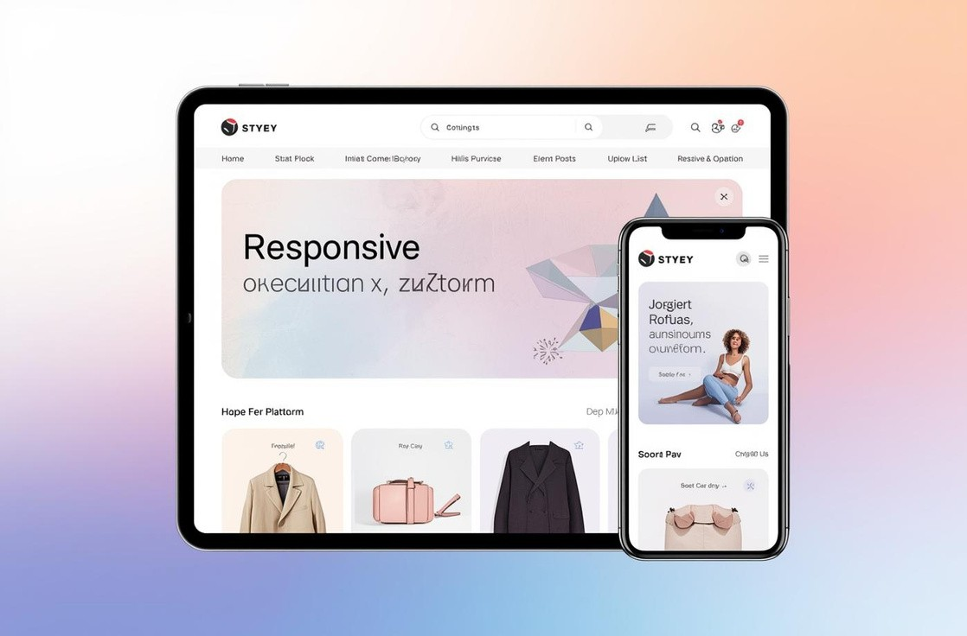

Key Features of Our E-Commerce Website
HOME
Intuitive layout for easy navigation and browsing.
CART
Seamless integration for managing selected products.
WISHLIST
Save favorite items for future purchases.

Slide 13
Challenges and Learnings
LIMITATIONS FACED
The project faced significant limitations due to reliance on HTML/CSS, restricting design flexibility and advanced interactivity within the application.
CREATIVE GROWTH
Despite challenges, the team experienced improved code structure and increased creativity in problem-solving, enhancing our development skills and adaptability.

Slide 14

System Workflow for E- Commerce Checkout
SHOPPING CART AND PURCHASE PROCESS
This workflow diagram illustrates the seamless process from product selection to checkout, ensuring an efficient user experience throughout the purchase journey.

Slide 15
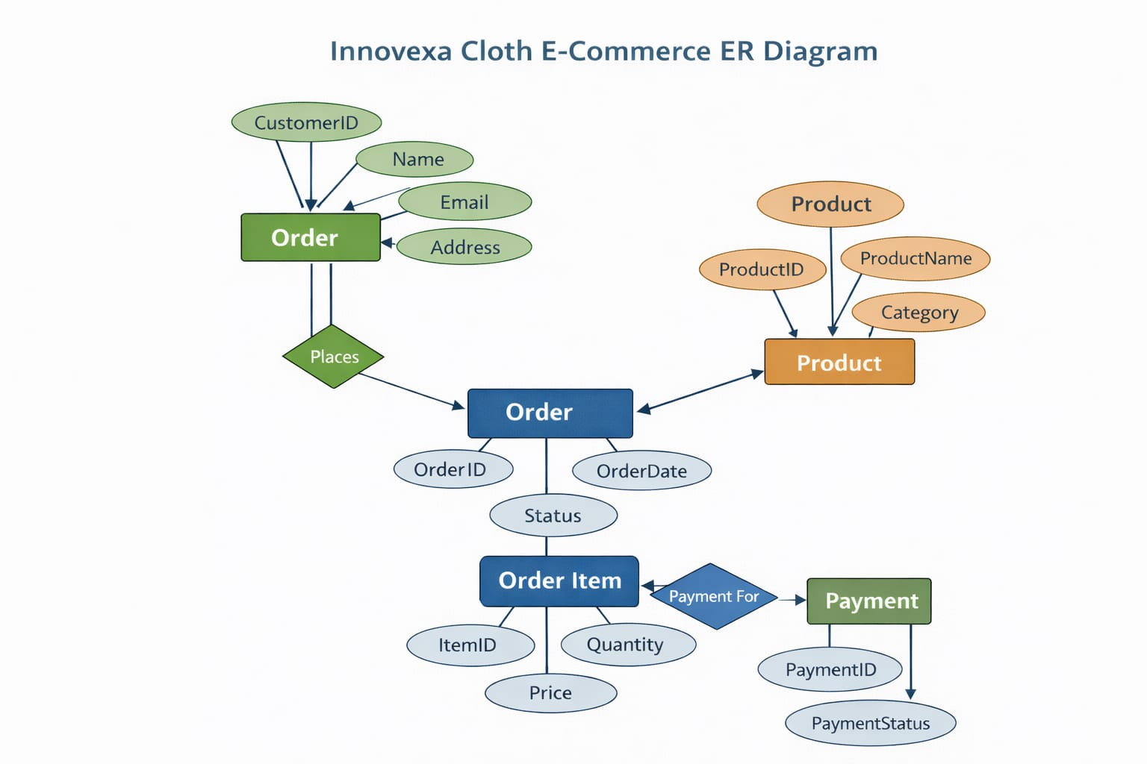

Slide 16
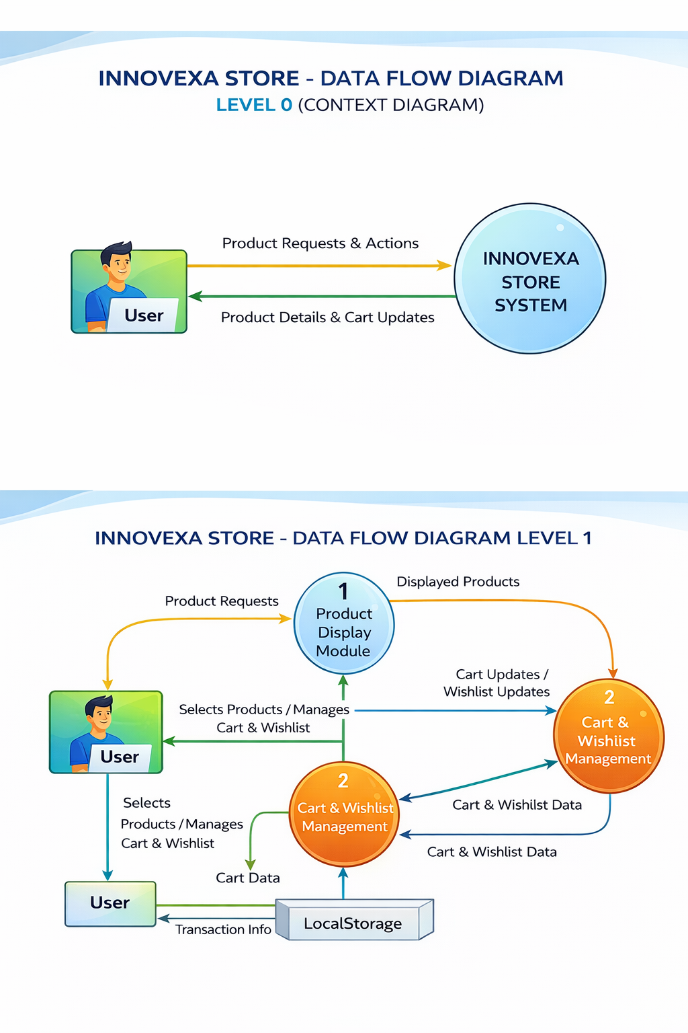

Slide 17
Future Growth Opportunities
BACKEND DEVELOPMENT POTENTIAL
As we look forward, the integration of backend services will significantly enhance our system.
Key areas for improvement include: Streamlined data management Enhanced user authentication
Improved performance through scalable architecture These advancements will support future growth.

Slide 18
Thank You for Your Attention

